Slide 1
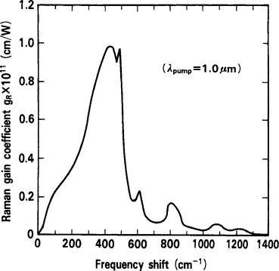
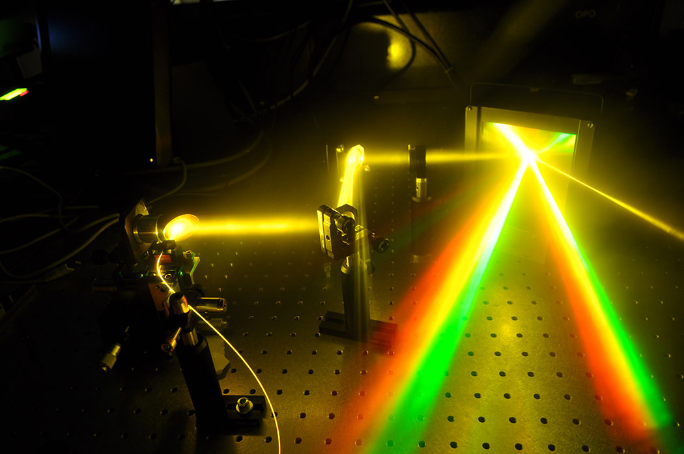
Color Acquisition Device (CAD)
Okamoto, Katsunari. Fundamentals of optical waveguides. Academic press, 2006.
Group 3
Cesar Lopez-Zelaya (OP)
Noah Richter (OP)
Kyle Hoofman (EE)
David Rothaus (EE)
Source: SPIE
Notes:
Cesar LZ

Slide 2
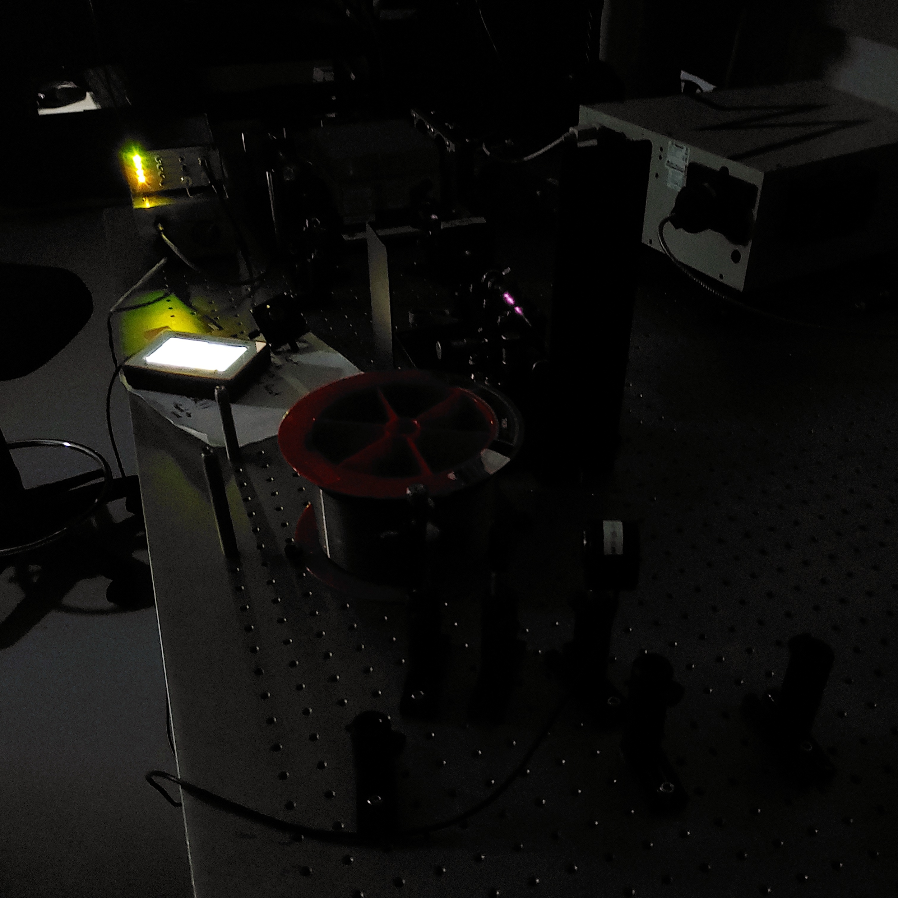
Overview
Project overview
Motivation
Goals and objectives
Optical design
Optical prototyping
Budget
Sponsors
Notes:
Cesar LZ

Slide 3
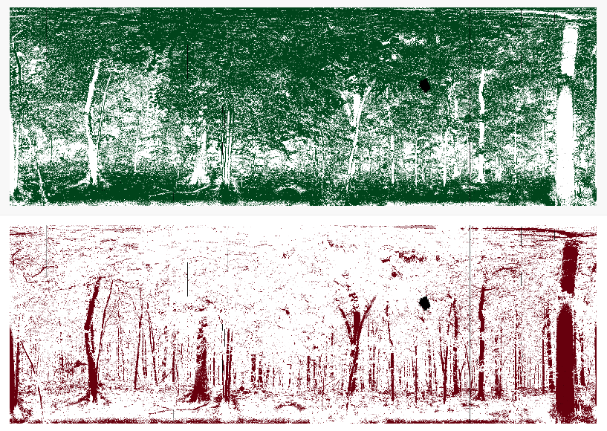
Motivation
Most laser detection and ranging (LADAR) systems are currently limited to one wavelength.
If other wavelengths are introduced, systems tend to get bulkier due to the need to incorporate diffractive optics and additional cavities.
Stimulated Raman scattering in optical fibers enables the generation of new colors when using intense pulses of light without the need of extra cavities.
These different colors posses different shapes in time, which can be used to tell them apart with a single detector and be used to identify object reflectivities.
https://www.umb.edu/spectralmass/lidar/dwel
Notes:
Cesar LZ

Slide 4
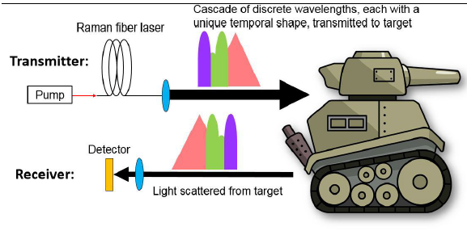
Goals and Objectives
Main goals
Design and build a fiber laser capable of converting a strong pump laser beam into multiple coherent colors.
Use the colors’ shape in the time domain to tell them apart and use that to characterize different objects based on how they reflect those colors.
Be able to send data obtained and computer inputs via bluetooth for the circuit board to display remotely.
Stretch goals:
Implement machine learning to identify objects
Ausley, Luke, Christian Keyser, and Richard Martin. "Temporally multiplexed multispectral ladar with Raman-based waveforms." Laser Radar Technology and Applications XXIII. Vol. 10636. International Society for Optics and Photonics, 2018.
Notes:
Cesar LZ

Slide 5
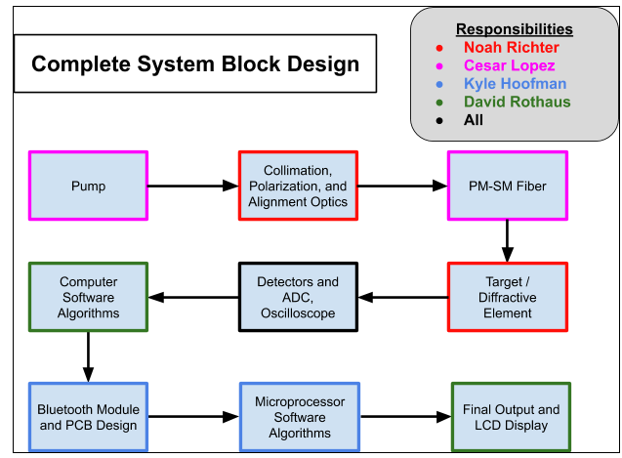
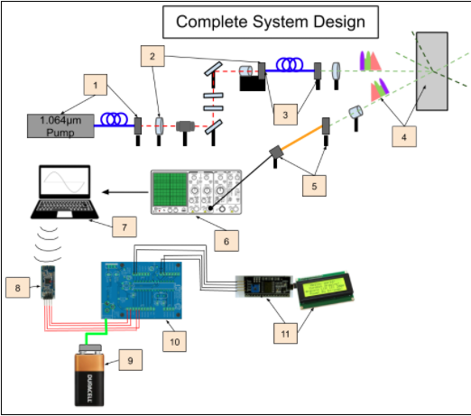
Complete System Block Diagram
Notes:
Cesar LZ

Slide 6
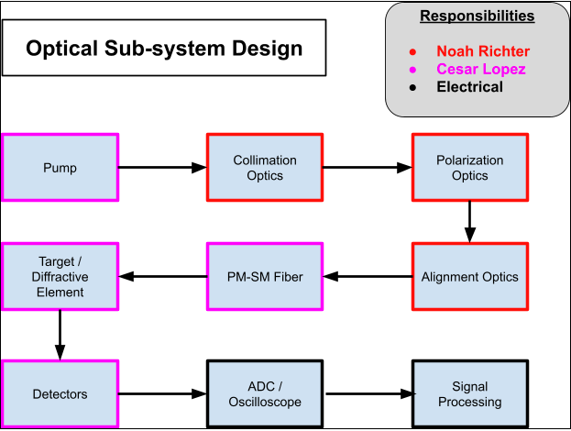
Optical Subsystem Block Diagram
Notes:
Noah

Slide 7
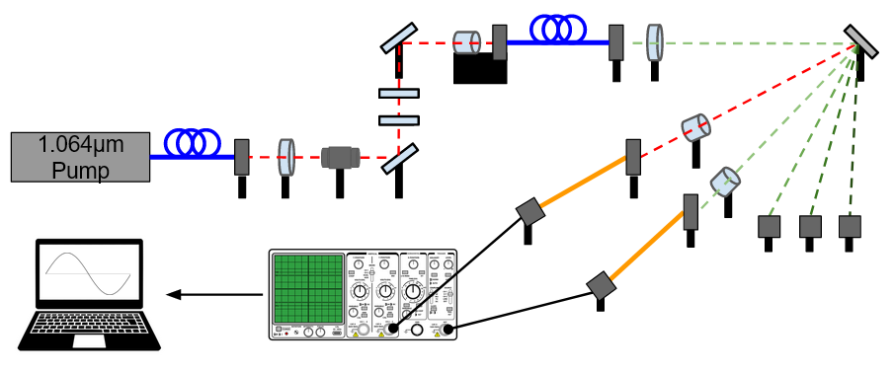
Optical Calibration Stage
Raman fiber-laser based object classifier and detector schematic for calibration phase. Each Stokes wavelength will be separately characterized and used to build a beam envelope that will be used in the application stage.
Notes:
Noah

Slide 8
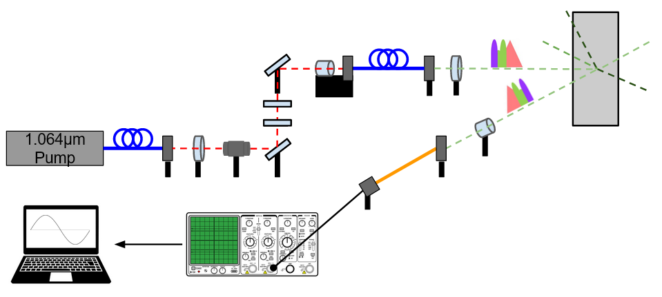
Optical Application Stage
Raman fiber-laser based object classifier and detector schematic for application stage. Here, the oscilloscope will detect the envelope that will change depending on the target (gray rectangle).
Notes:
Noah

Slide 9
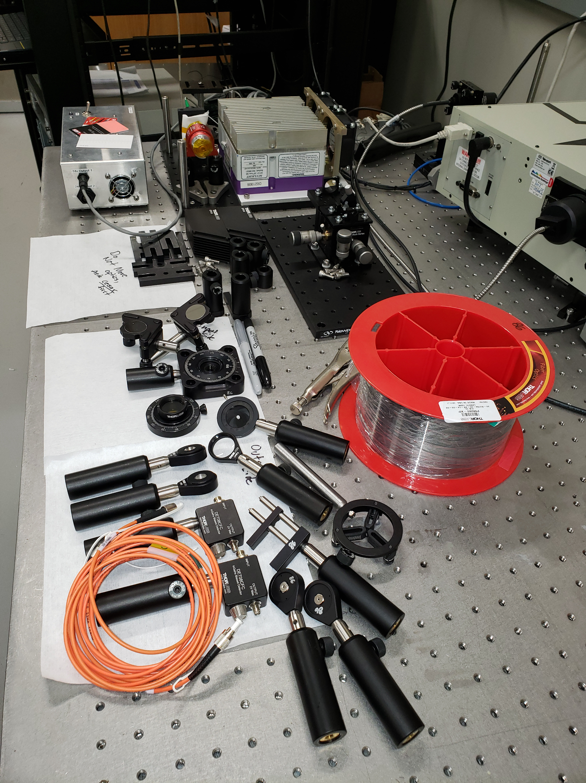
Optical prototyping
The beginnings of our laser
Notes:
Noah

Slide 10
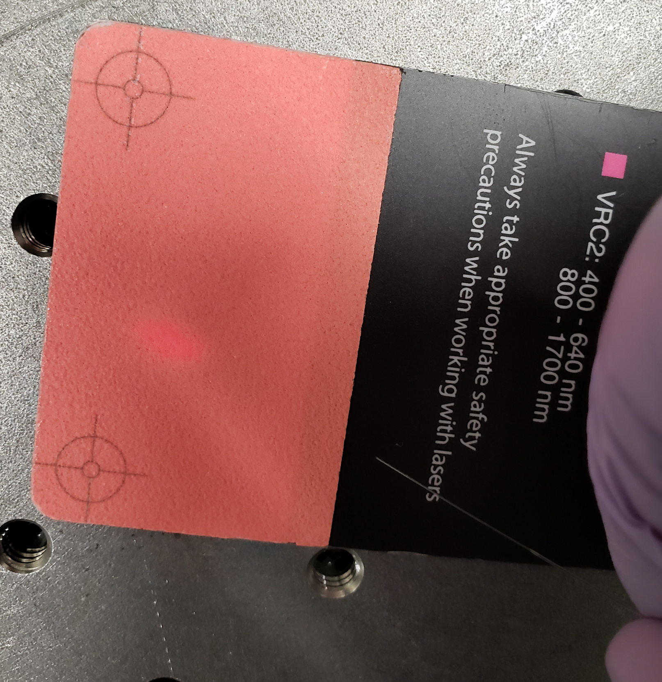
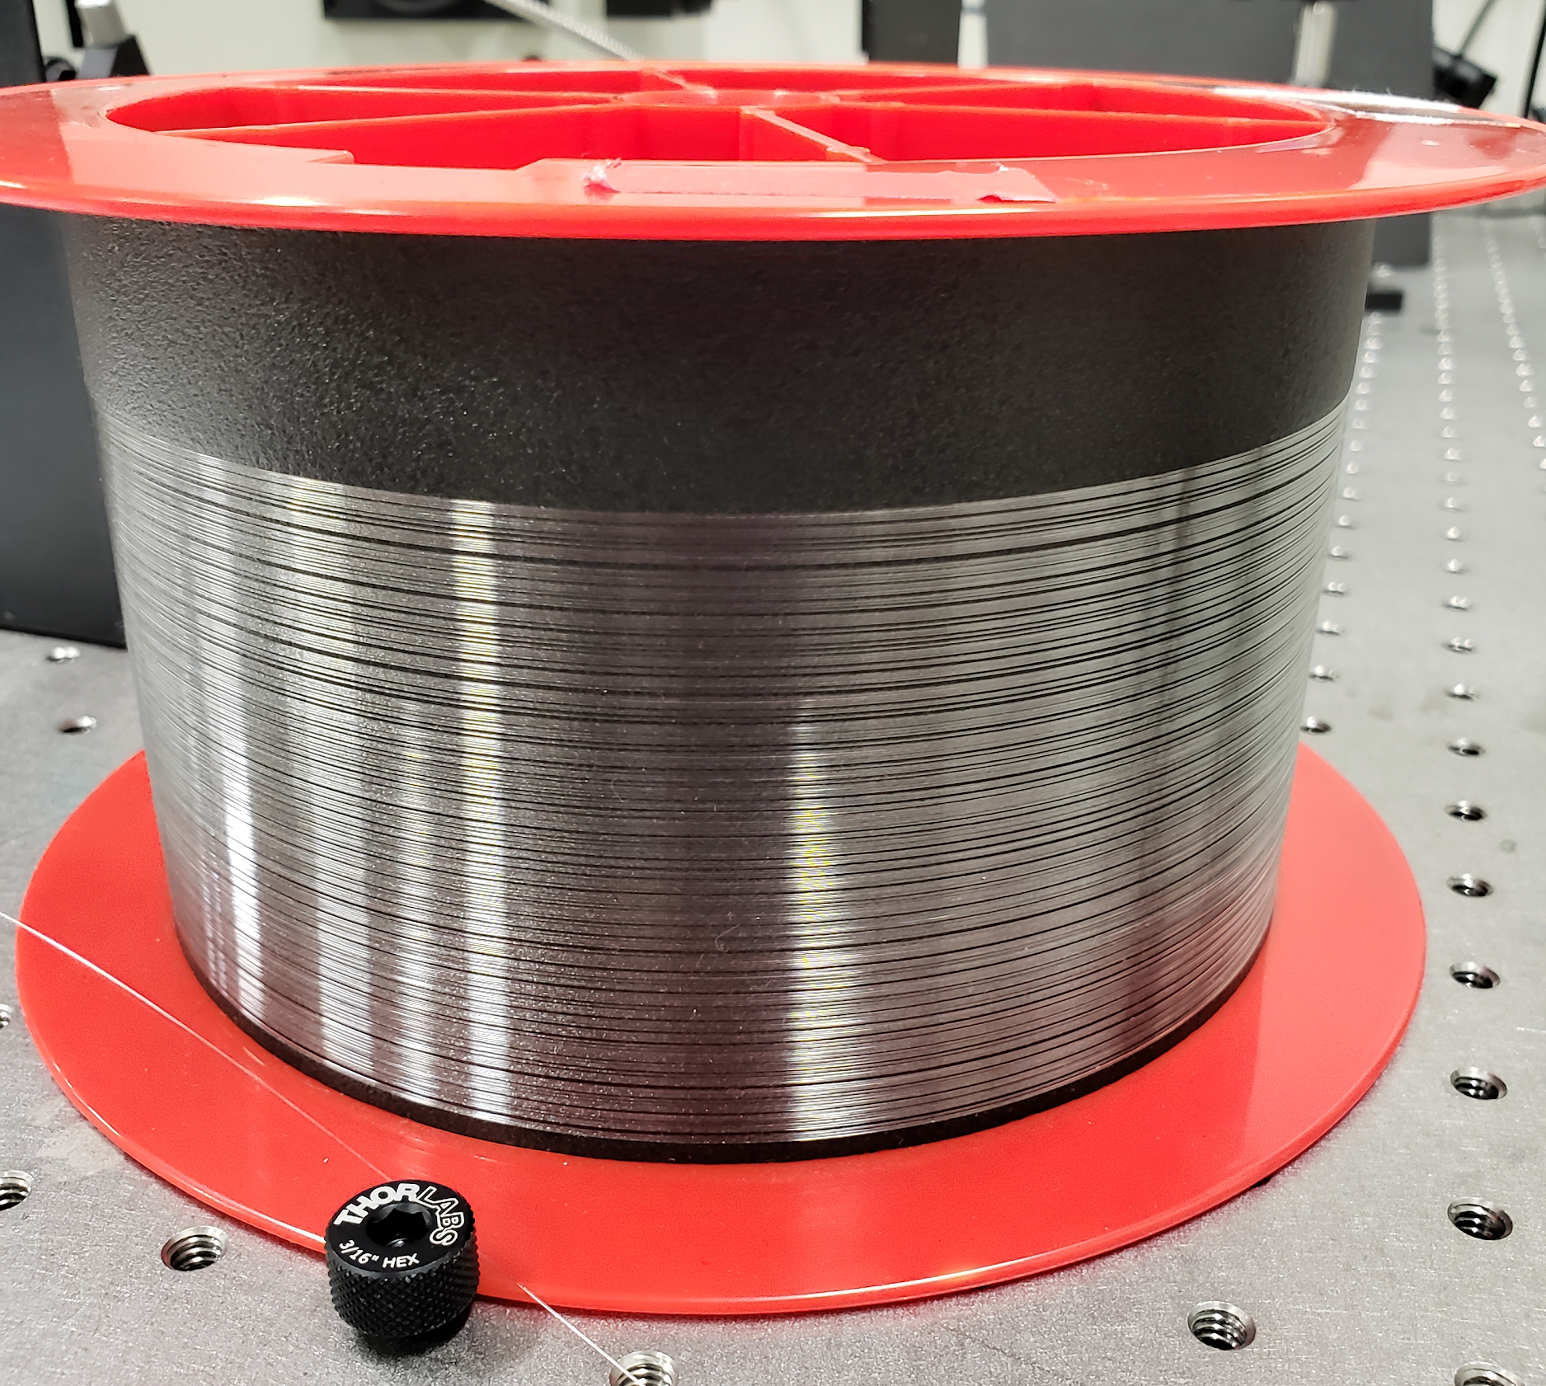
Optical prototyping
“Panda-style” single-mode polarization preserving fiber
Maintains polarization of light for maximized Raman gain
100m long for single-pass ASE
Source: Wikipedia
Notes:
Noah

Slide 11
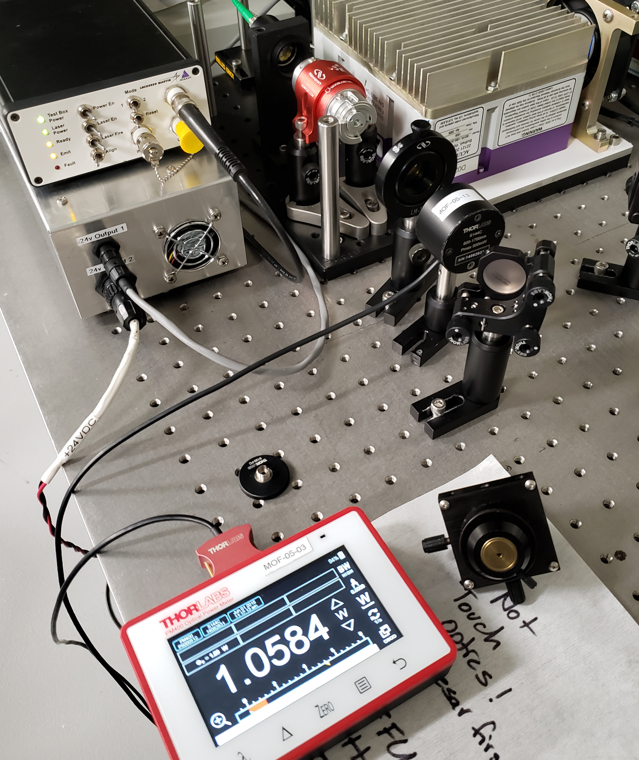
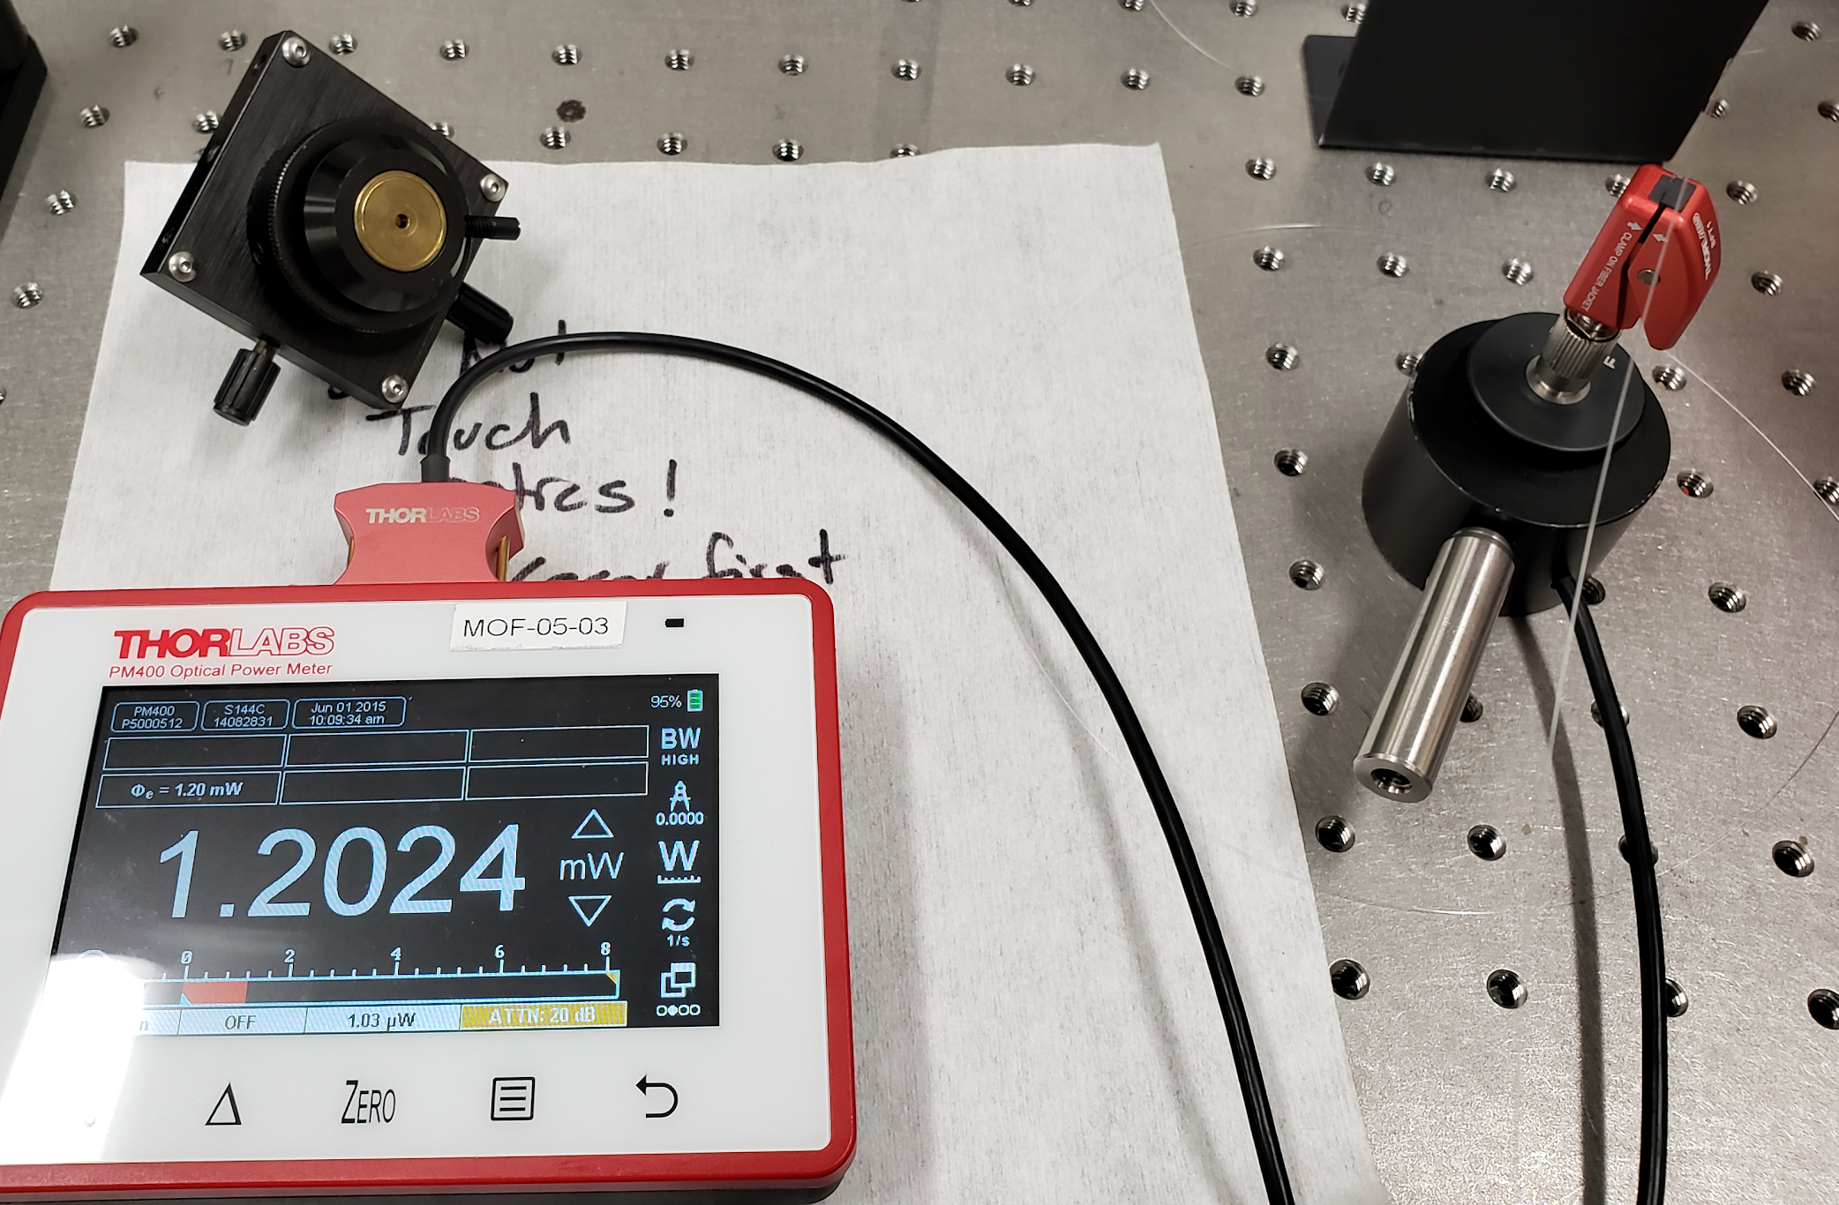
Optical prototyping
Pump laser and polarization power control test (right)
Waveplate and fiber coupling test (left)
Best fiber coupling efficiency is 17-21%
Note: tests done separately!
Notes:
Noah

Slide 12
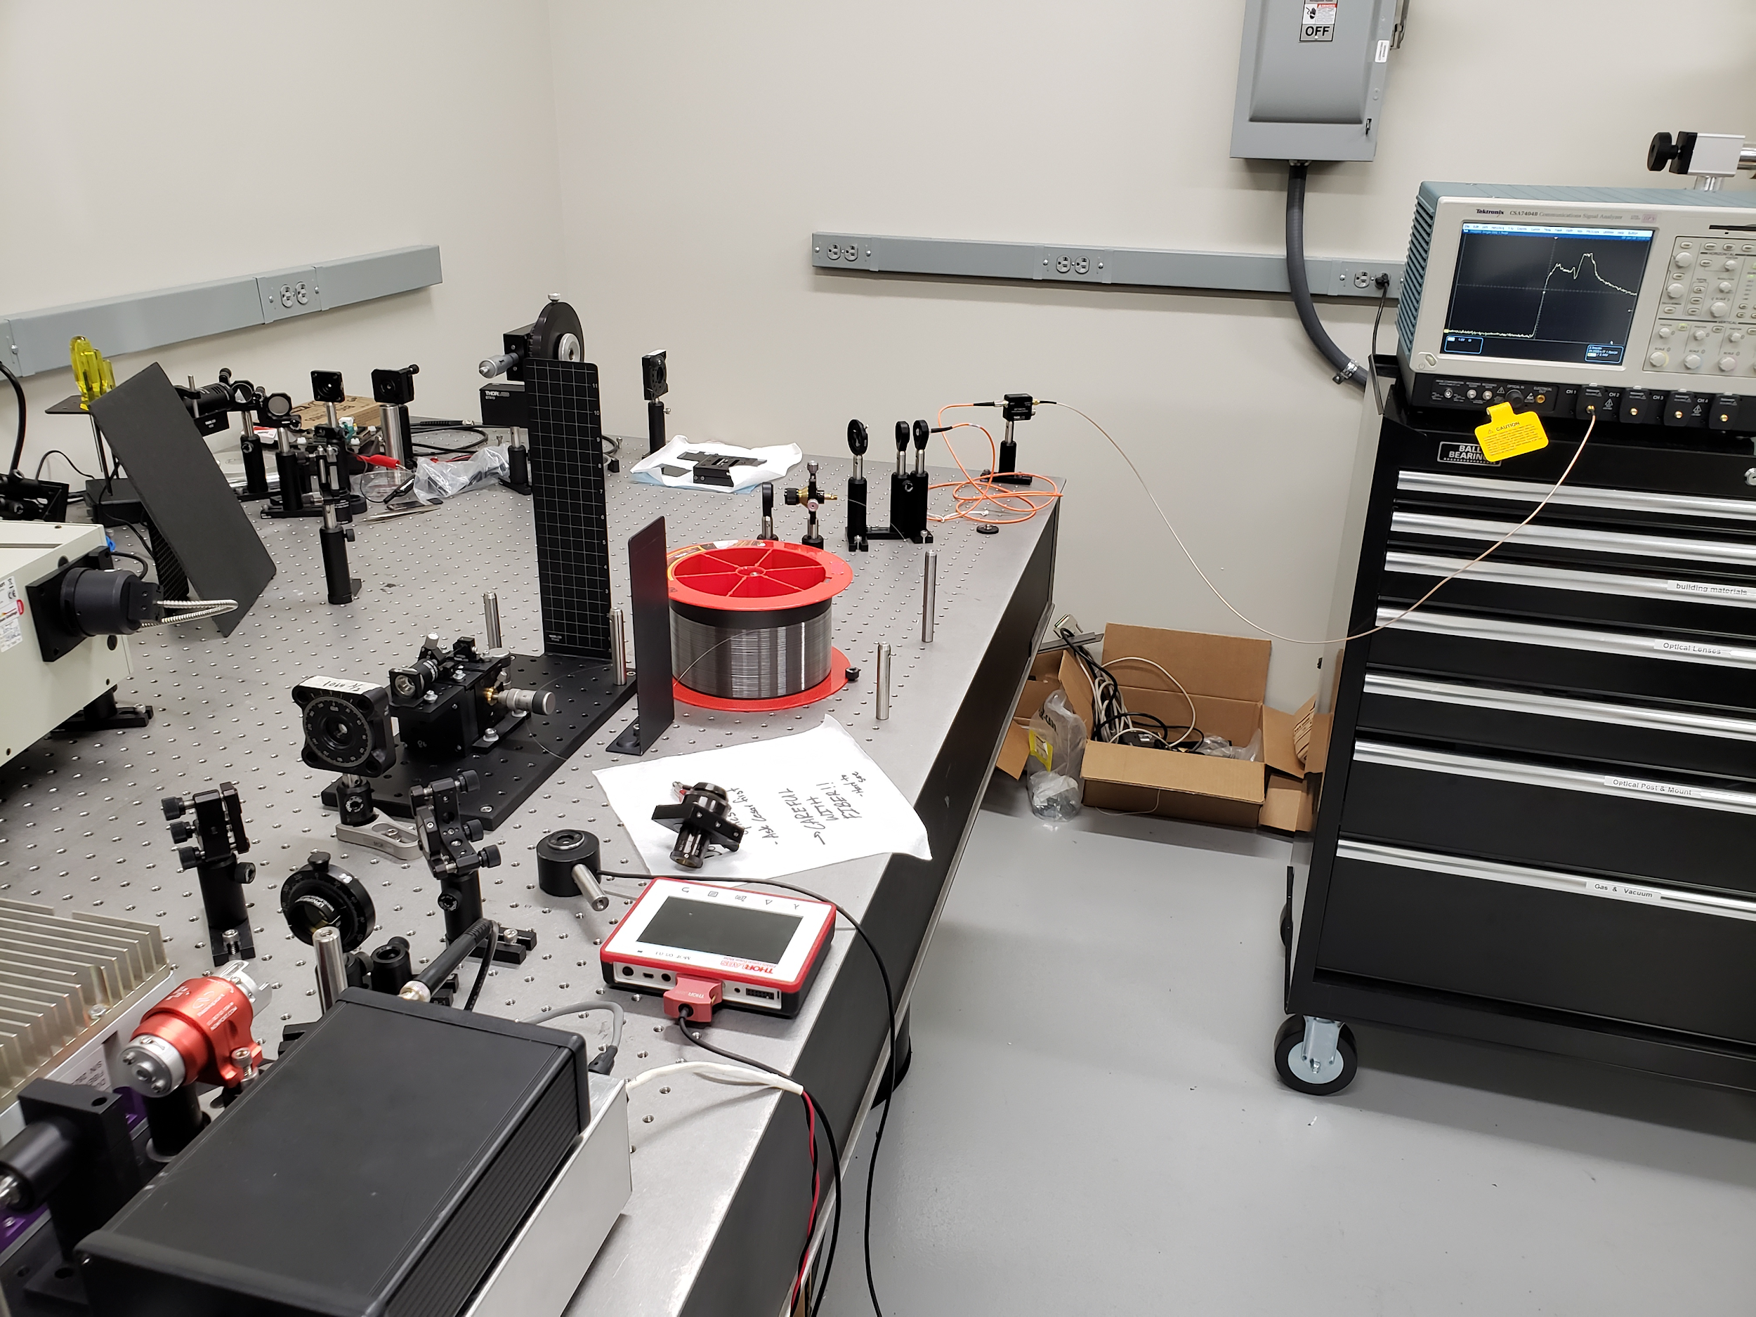
Optical prototyping
Finalized prototype!
Consists of three Parts:
Light pumping and gain
Free-space transmission and diffraction
Wavelength scanning in the time domain
Notes:
Noah

Slide 13
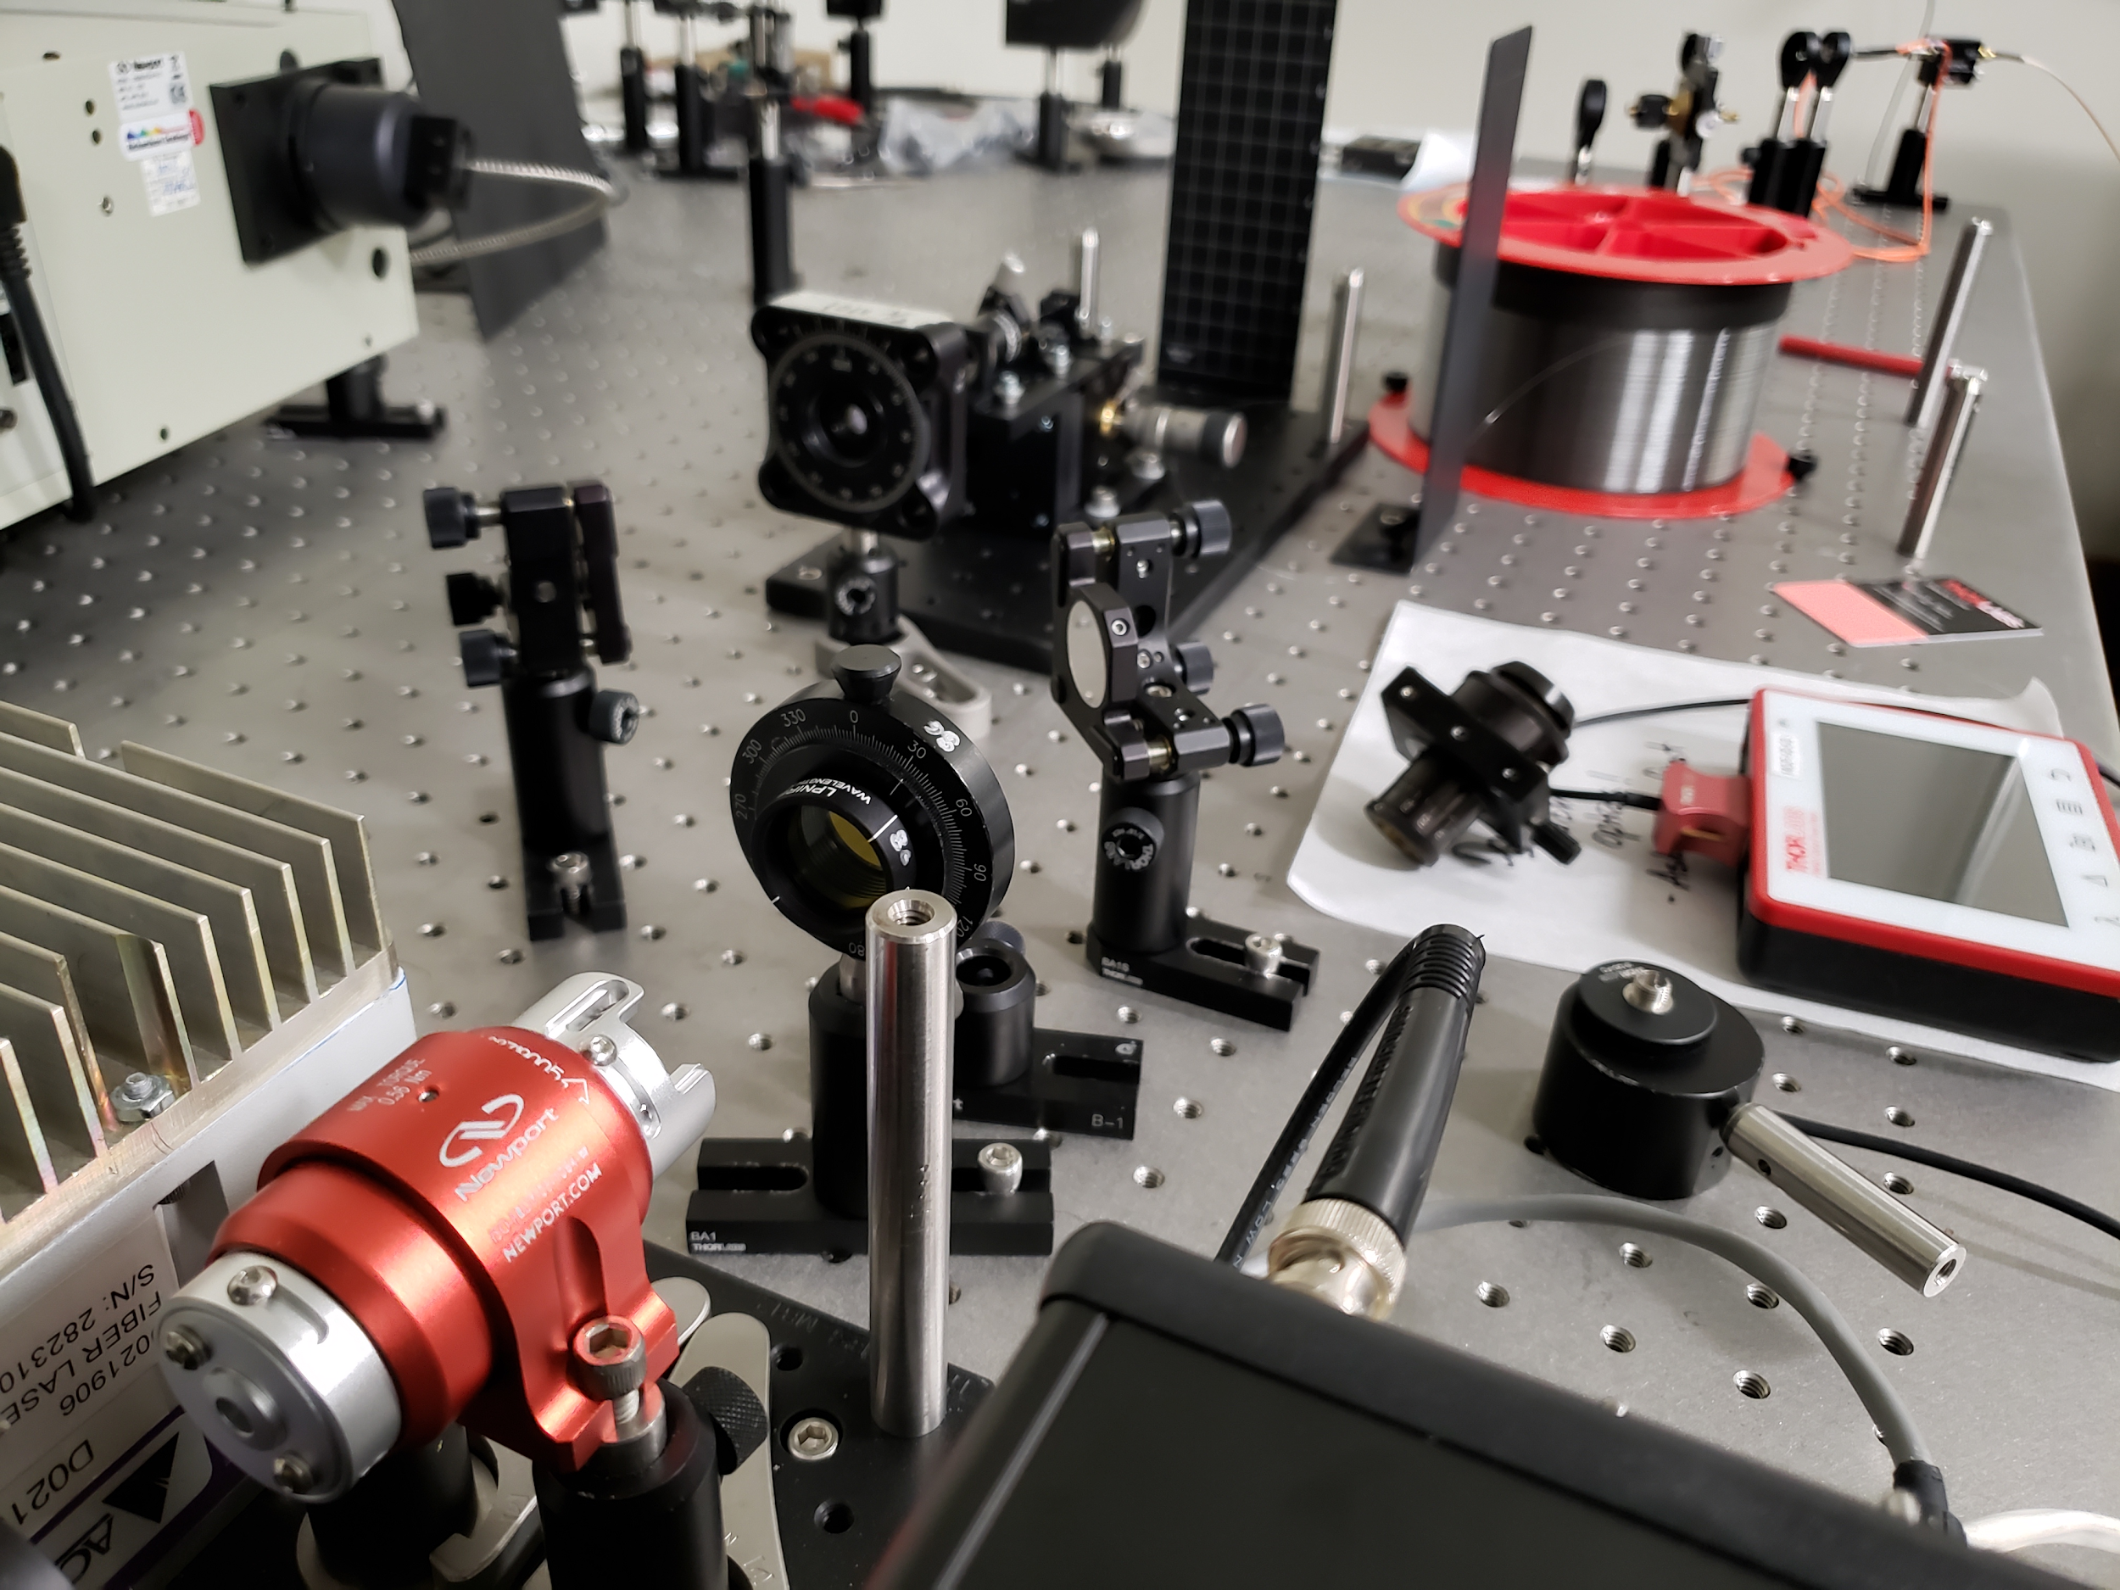
Optical prototyping
Light pumping and gain

Slide 14
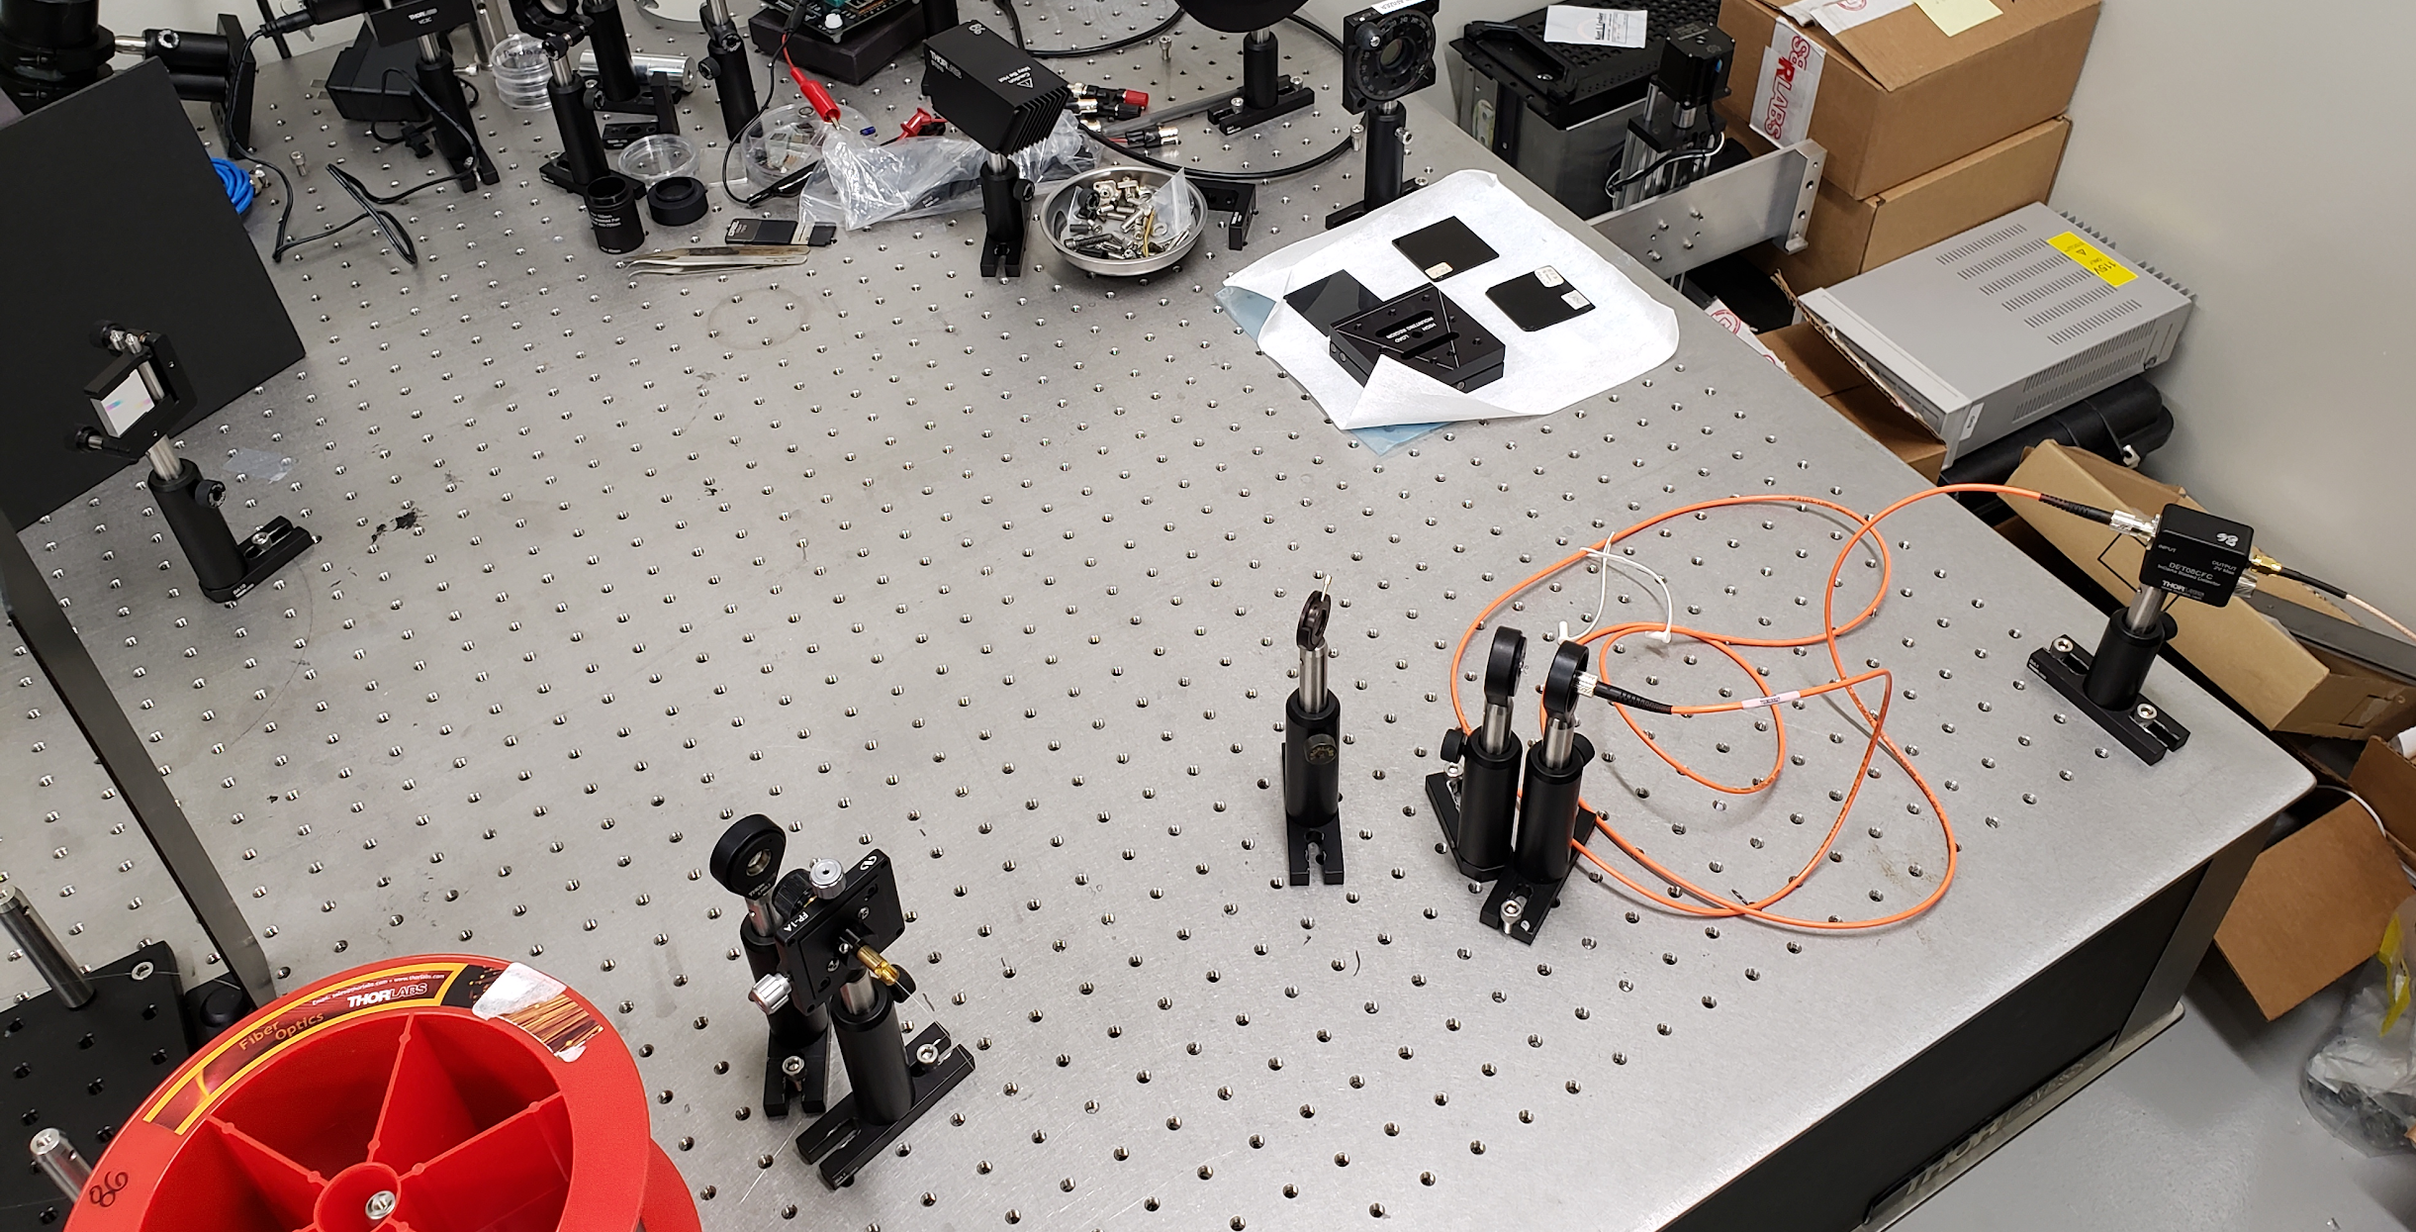
Optical prototyping
Free-space transmission and diffraction

Slide 15
Optical prototyping
Our fiber has a 14.09THz shift
(1064->1120)
Slightly smaller shift occurs at 1120->1178
Another shift occurs at 9.71THz
(1064->1102)
1064.76um
1120.48um
1178.72um
Notes:
Noah

Slide 16
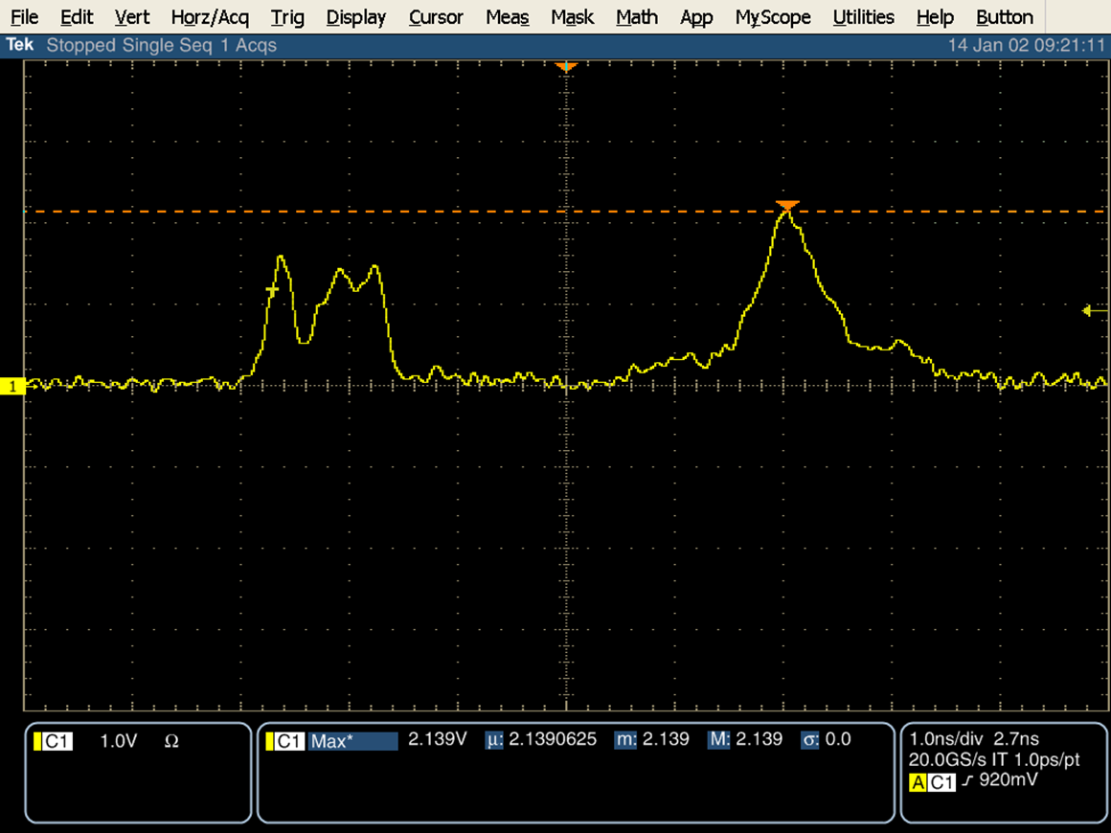
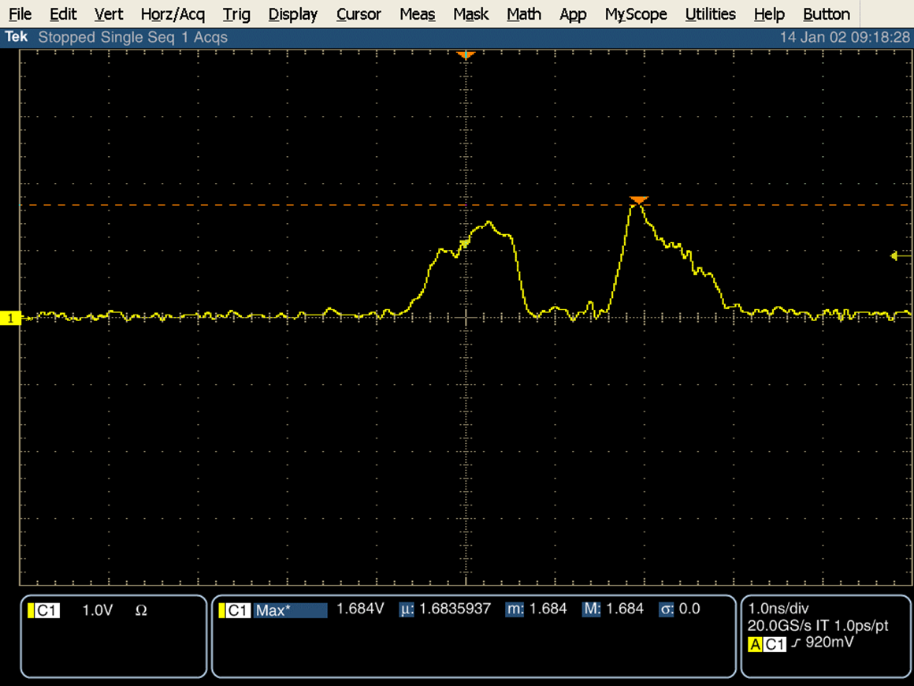
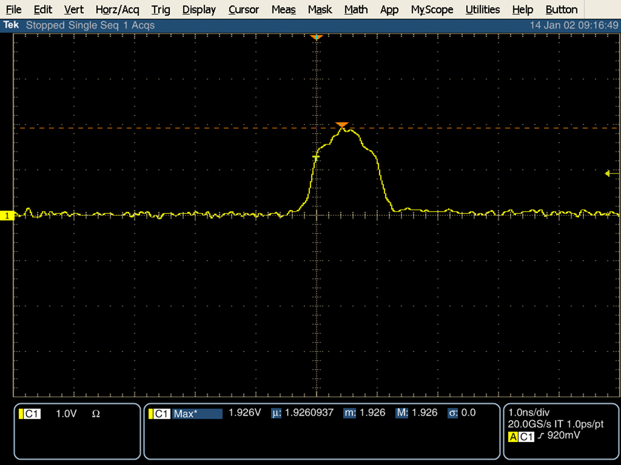
Optical prototyping
Wavelength scanning in the time domain
Note: waveforms shown are for lower laser power
1064.76um
1120.48um
1178.72um

Slide 17
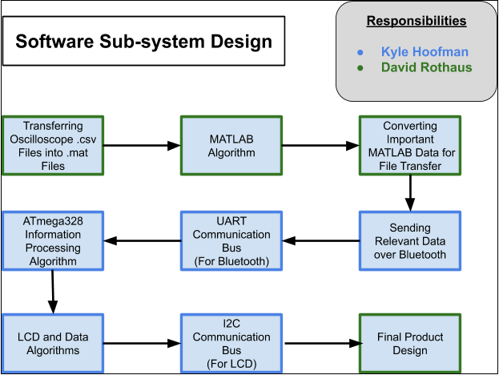
Software Subsystem Block Diagram
Notes:
Kyle

Slide 18
Software
Matlab or Python code
Waveform Algorithm
CSV parsing
Waveform algorithm using least squares method
Machine learning to identify object
Bluetooth communication
$S\left(t\right)=\sum_{m=0}^{N}{P\left(t±τ,m\right)k\left(λ_{m}\right)}$
Notes:
Kyle & whoever wants to talk about Matlab

Slide 19
Optical Budget
ITEM | PART # | Description | QUANTITY | PRICE ESTIMATE (PER-ITEM)
DC Power Supply for MCU | Agilent E3620A | Output Ratings (Maximum current is derated 3.3% per °C from 40°C to 55°C), Output 1: 0 to 25 V, 0 to 1 A, Output 2: 0 to 25 V, 0 to 1 A, Power (max): 50 W, Ripple & Noise from 20 Hz to 20 MHz, Normal Mode Voltage rms: 350 µV, Peak-to-Peak: 1.5 mV, Load & Line Regulation, 0.01% + 2mV, Meter Resolution, Voltage: 10 mV (0-20 V), 100 mV, (>20 V), Current: 1 mA | 1 | 10$
1.064m pump laser | Lockheed Martin: M31PL-10 5-20-3.0-0.3-ST (Telesto) |  | 1 | $30,000
Optical isolator | ISO-FRDY-05-1064-W | Faraday Optical Isolator, High Power, 5mm, 1064nm, ½ Waveplate | 1 | $1650
Microscope Objective Lens | LMH-20x- 1064 | High-Power MicroSpot Focusing Objective, 20X, 980 - 1130 nm, NA = 0.40 | 1 | $1659.97
Mounted Polarizer | LPNIRB100-MP2 | Ø1" SM1-Mounted Linear Polarizer, 650 - 1100 nm | 1 | $705.99
Half-wave plate | AHWP10M-980 | Ø1" Mounted Achromatic Half-Wave Plate, SM1-Threaded Mount, 690 - 1200 nm | 1 | $919.44
Fiber Adapter Plate | SM1FC | FC/PC Fiber Adapter Plate with External SM1 (1.035"-40) Threads, Wide Key (2.2 mm) | 2 | $61.50
Focusing Lens | A230TM-C | F=4.51 mm, NA=0.54, Mounted Rochester Aspheric Lens, AR: 1050-1620 nm | 1 | $90.09
Focusing Lens | KBX061 | Uncoated, 1 inch (25.4 mm) diameter, N-BK7 bi-convex lens with an effective focal length of 88.3 mm | 2-4 | $168

Slide 20
Optical Budget
Single Mode Fiber Launch | MBT610D | Single Mode Fiber Launch with Variable V-Groove Clamp | 1 | $1680.86
Rotation Mount | RSP1X15 | Rotation Mount for Ø1" (Ø25.4 mm) Optics, 360° Continuous or 15° Indexed Rotation, 8-32 Tap | 2 | 277.84
PM-SM fiber | PM980-XP | 970 - 1550 nm PM Fiber, 6.6 µm MFD | 100 | $1894.00
Multimode Fiber | M67L01 | Ø25 µm, 0.10 NA, FC/PC-FC/PC Fiber Patch Cable, 1 m | 2 | $212.10
Lens Cell Adapter 1 | S1TM12 | SM1 to M12 x 0.5 Lens Cell Adapter | 2 | $47.72
Lens Cell Adapter 2 | S1TM09 | SM1 to M9 x 0.5 Lens Cell Adapter | 1 | $23.86
Collimating lens | F810APC- 1064 | 1064 nm FC/APC Collimation Package, NA = 0.25, f = 36.60 mm | 1 | $265.12
Compact Flexure Plate Clamp | PC2 | Compact Flexure Plate Clamp, 1/4"-20 Tap | 1 | $22.07
Diffraction Grating | GR25-0310 | Ruled Reflective Diffraction Grating, 300/mm, 1 µm Blaze, 25 x 25 x 6 mm | 1 | $114.72
Diffraction Grating Mount | KM100C | Kinematic Mount for up to 1.3" (33 mm) Tall Rectangular Optics, Right Handed |  | $100.49
Lens Mount | LMR1 | Lens Mount with Retaining Ring for Ø1" Optics, 8-32 Tap | 5 | 78.45
FC/PC fiber connector |  |  | 4 | 15$
Beam stopper | BT610 | Beam Trap, 400 nm - 2.5 µm, 30 W Max Avg. Power, Pulsed and CW, 8-32 Tap | 2 | $627.80
Safety goggles | LG11 |  | 2 | $758.35

Slide 21
Sponsors
Air Force Research Laboratory (AFRL)
UCF faculty and research groups
Dr. Kyle Renshaw
Dr. Guifang Li
Dr. Peter Delfyett
Optical fiber communications (OFC) group
Microstructured optical fibers (MOF) group
Thank you!
Notes:
Cesar LZ

